Slide 1
NM ASSIGNMENT 2
Done By Yogeshwar R
Data Set Link: Human Resources Data Set (kaggle.com)

Slide 2
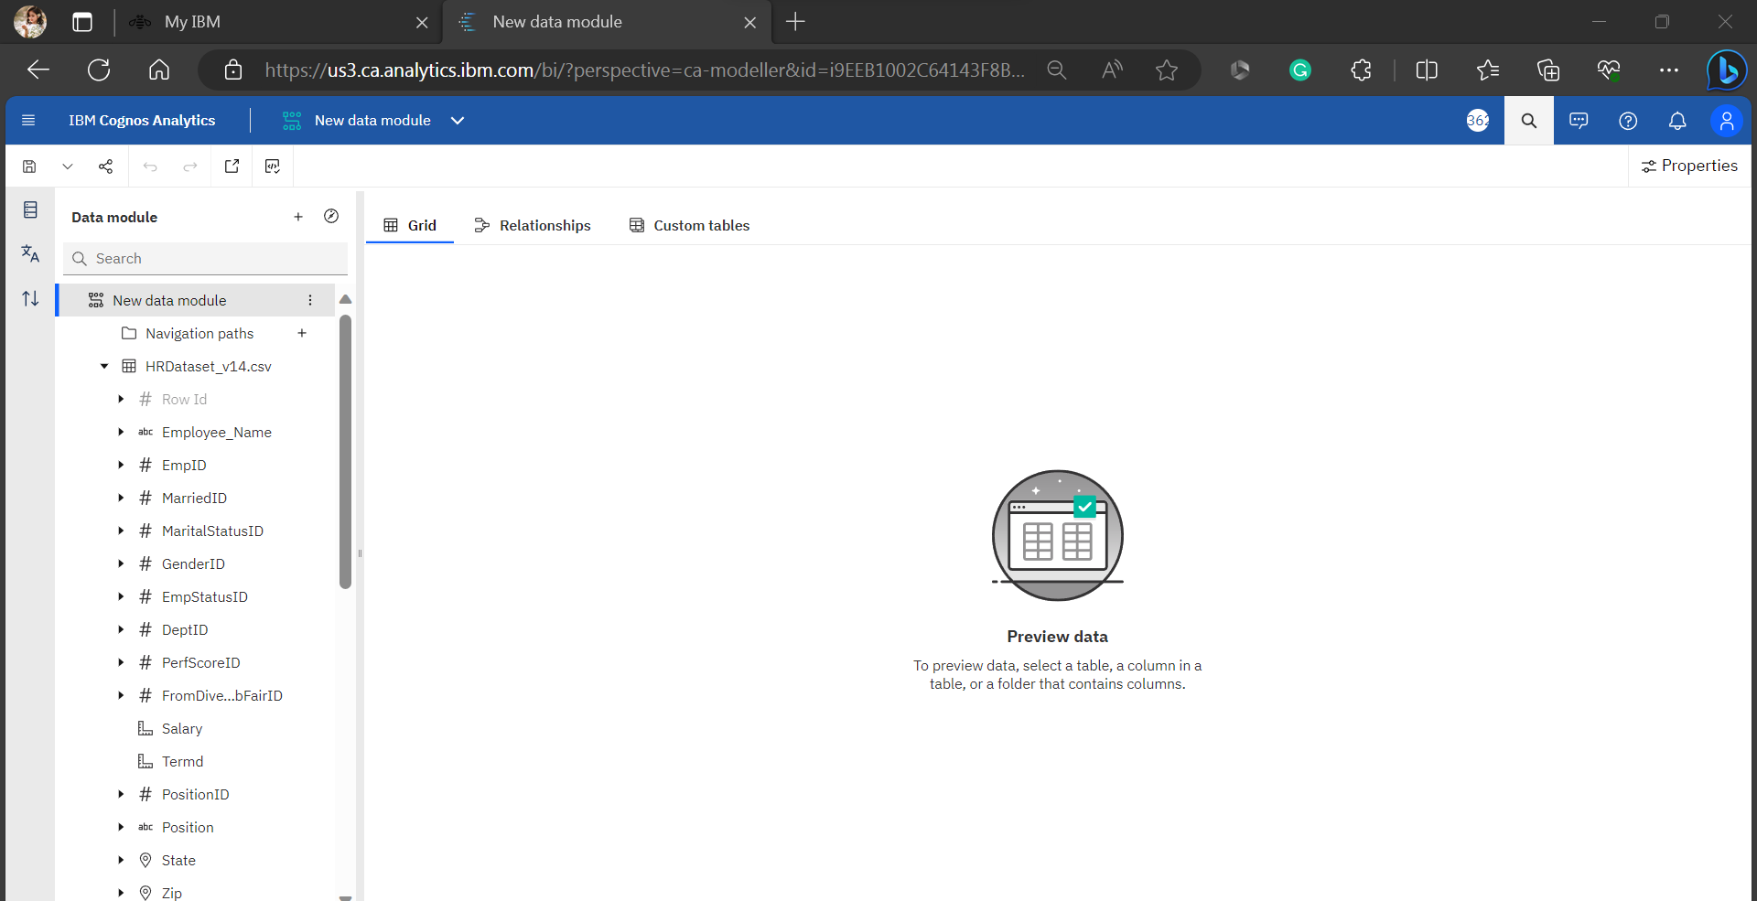
Step 1 : Create a new data module from the uploaded CSV file for visualizing data.

Slide 3
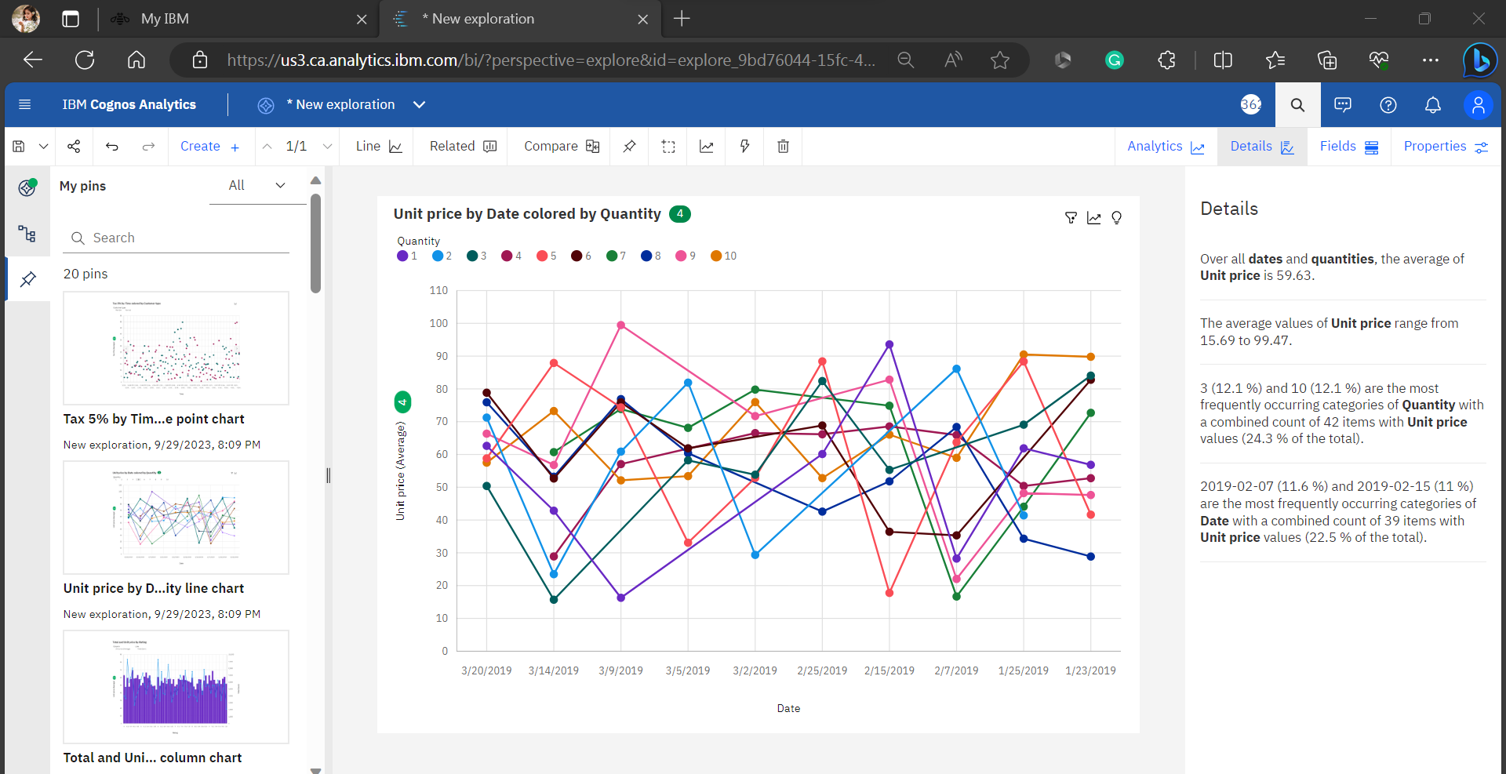
Step 2 : Using data module , create more explorations and pin it.

Slide 4
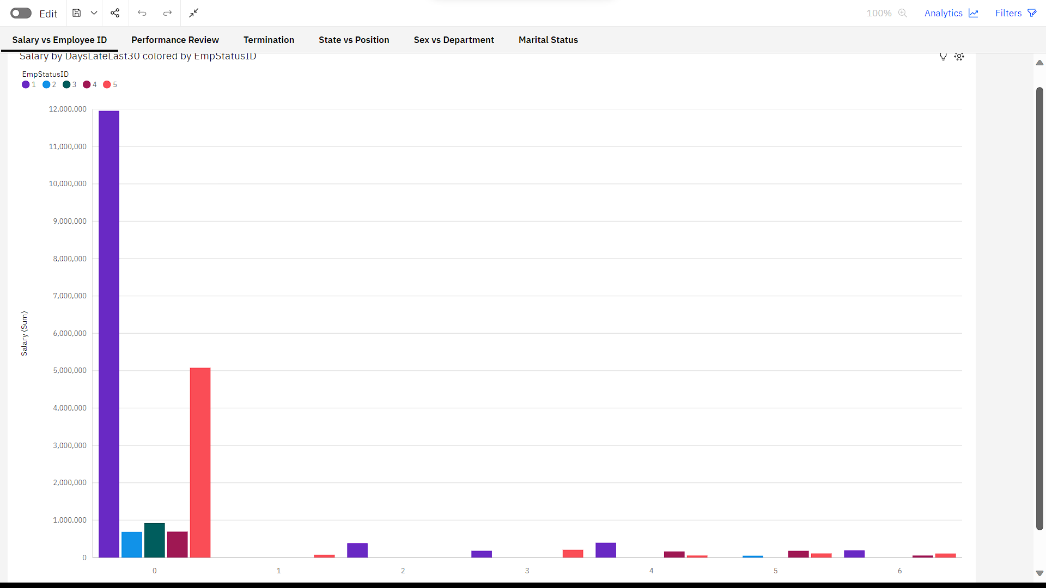
Step 3 : Using the pins, create Dashboard

Slide 5
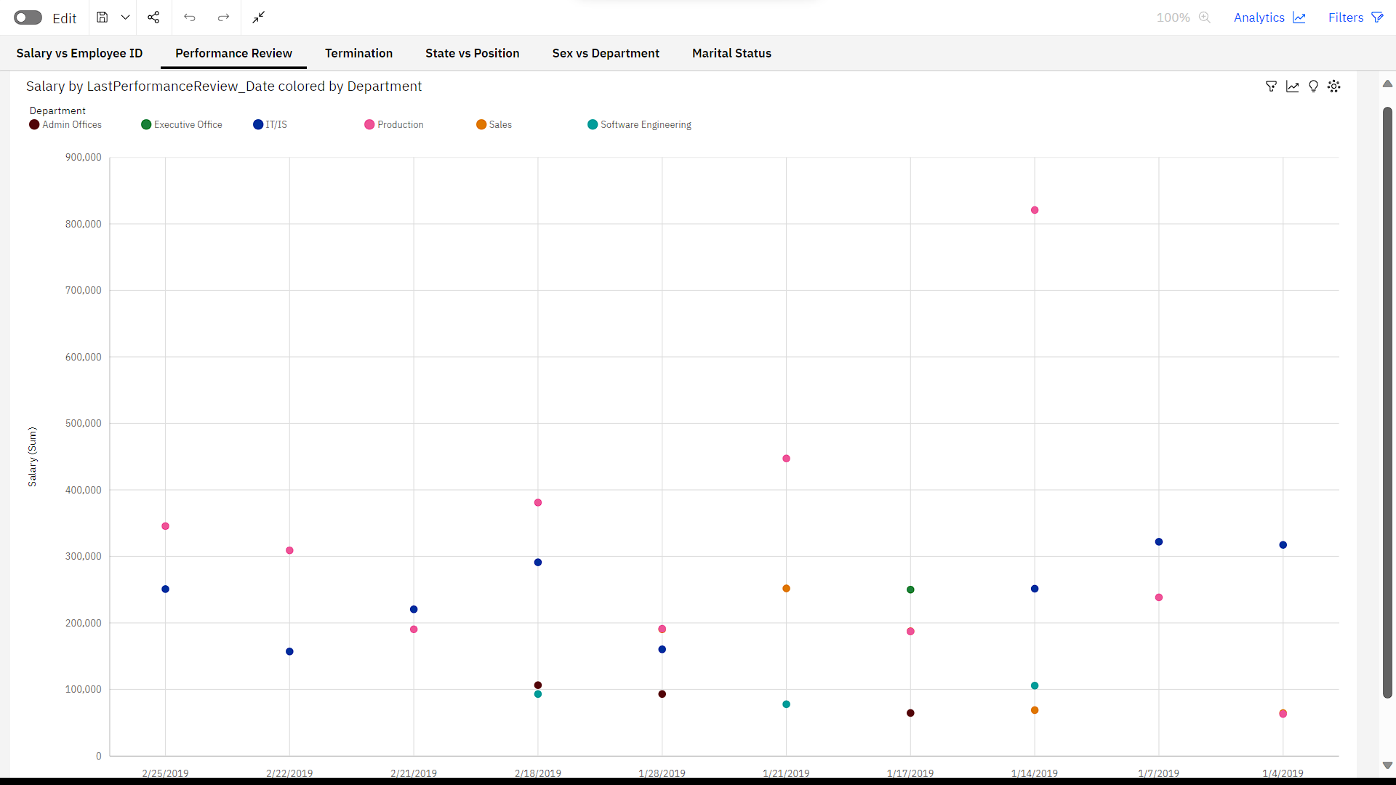

Slide 6
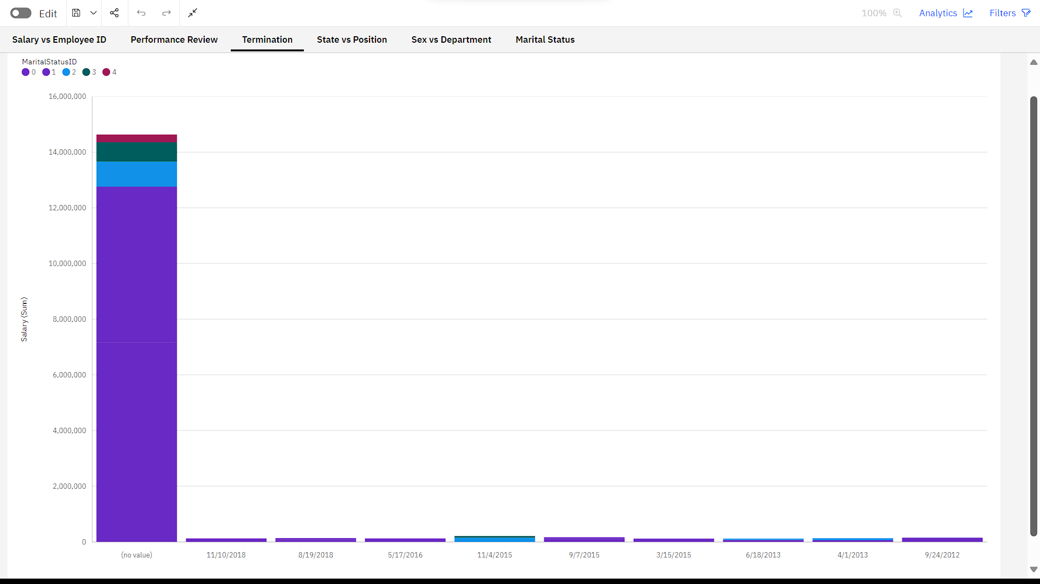

Slide 7
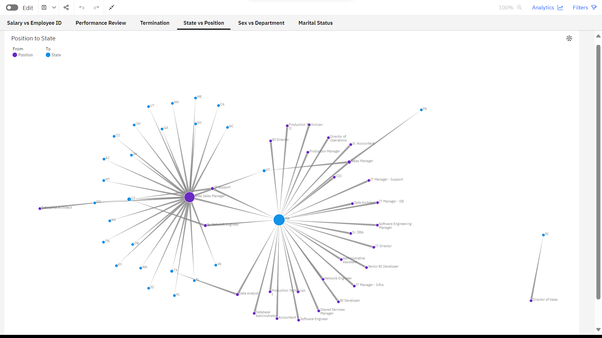

Slide 8
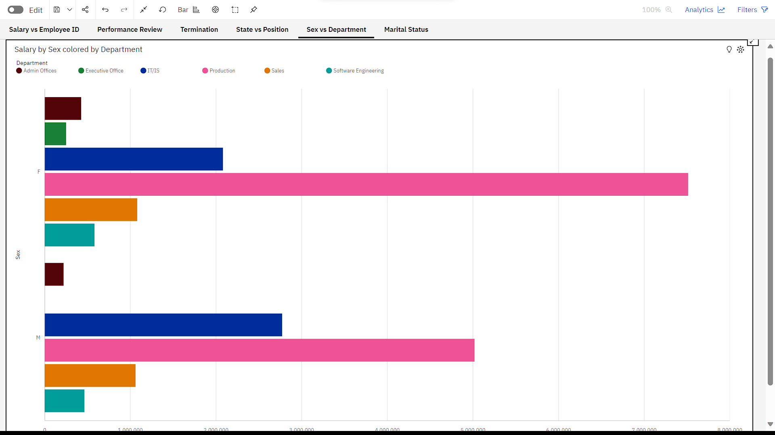

Slide 9
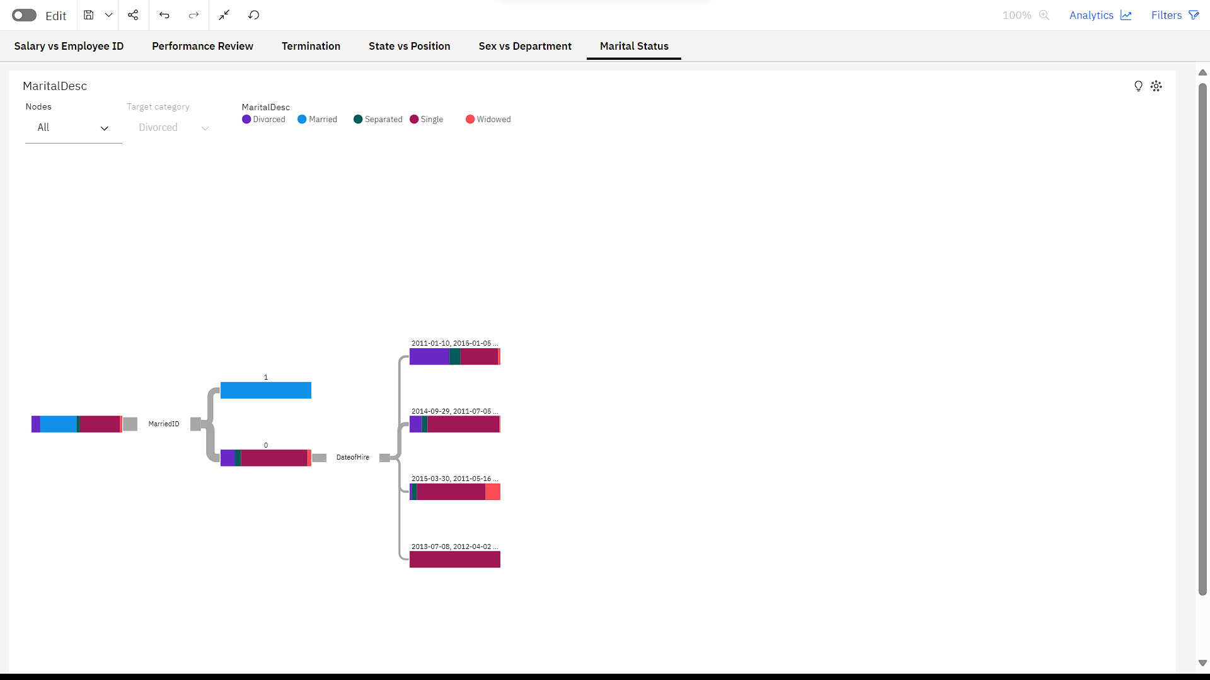

Slide 10
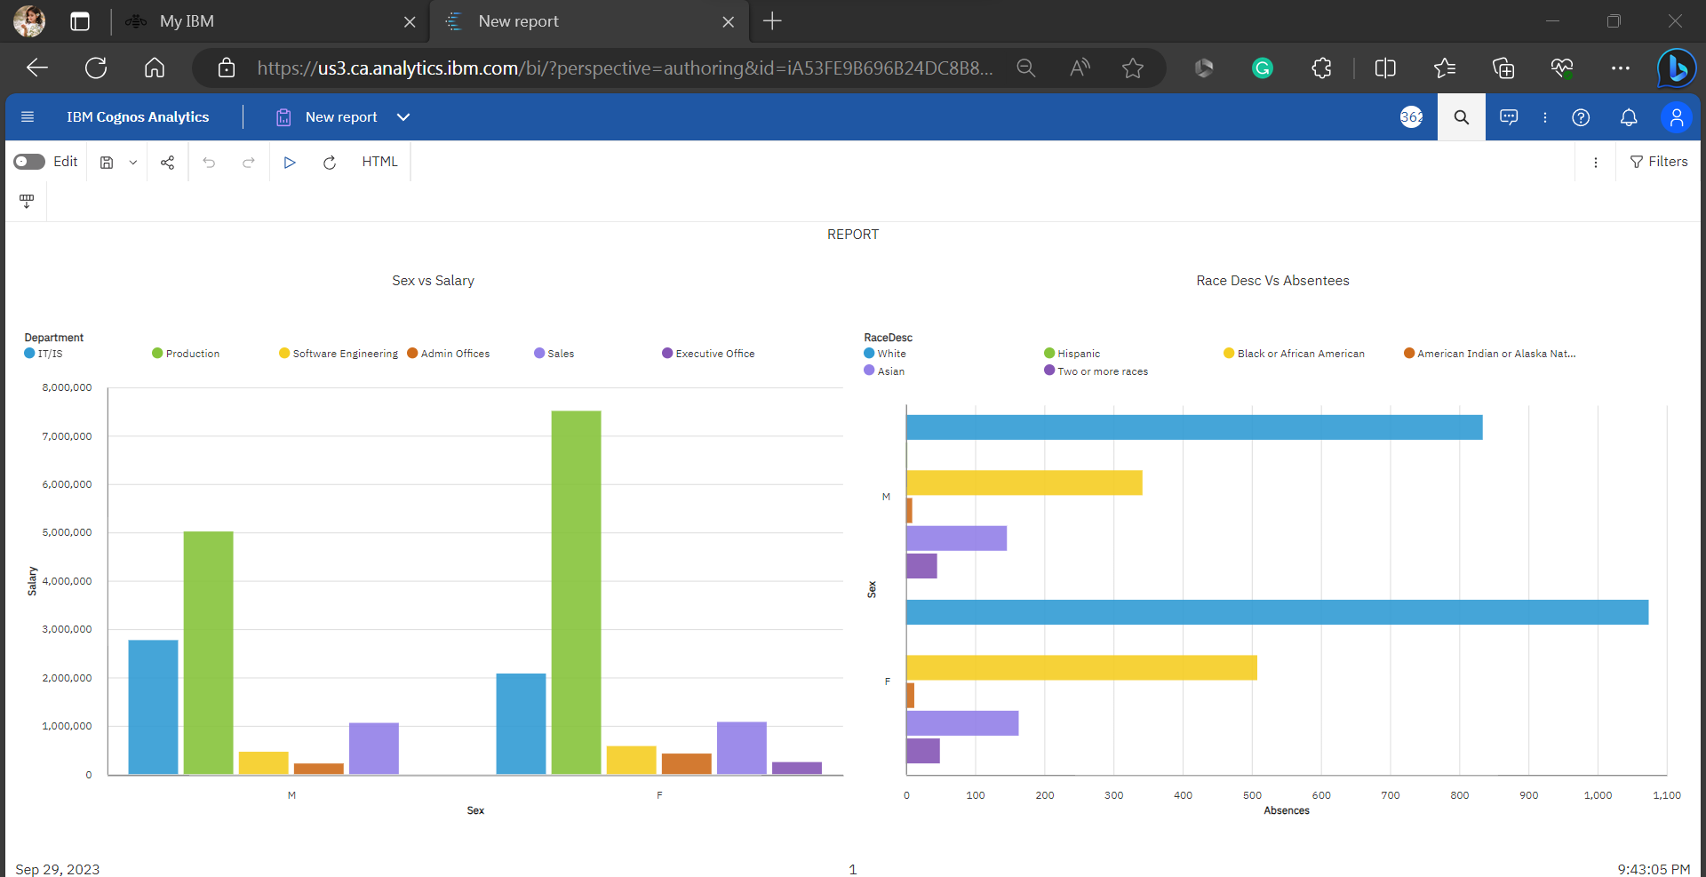
Step 4 : After done with that dashboard, Now create a report.

Slide 11
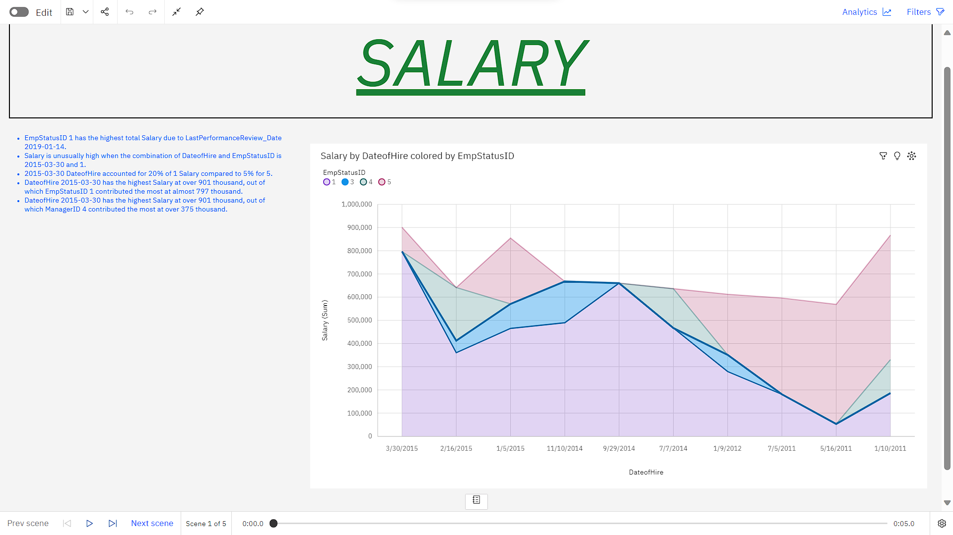
Step 5: After done with that report, Create a story to view our visualizations in the form of slides.

Slide 12
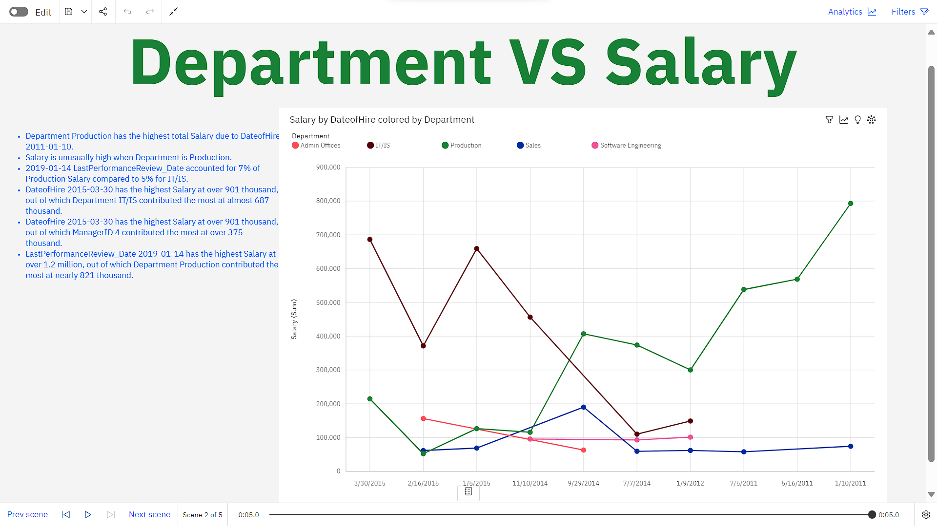

Slide 13
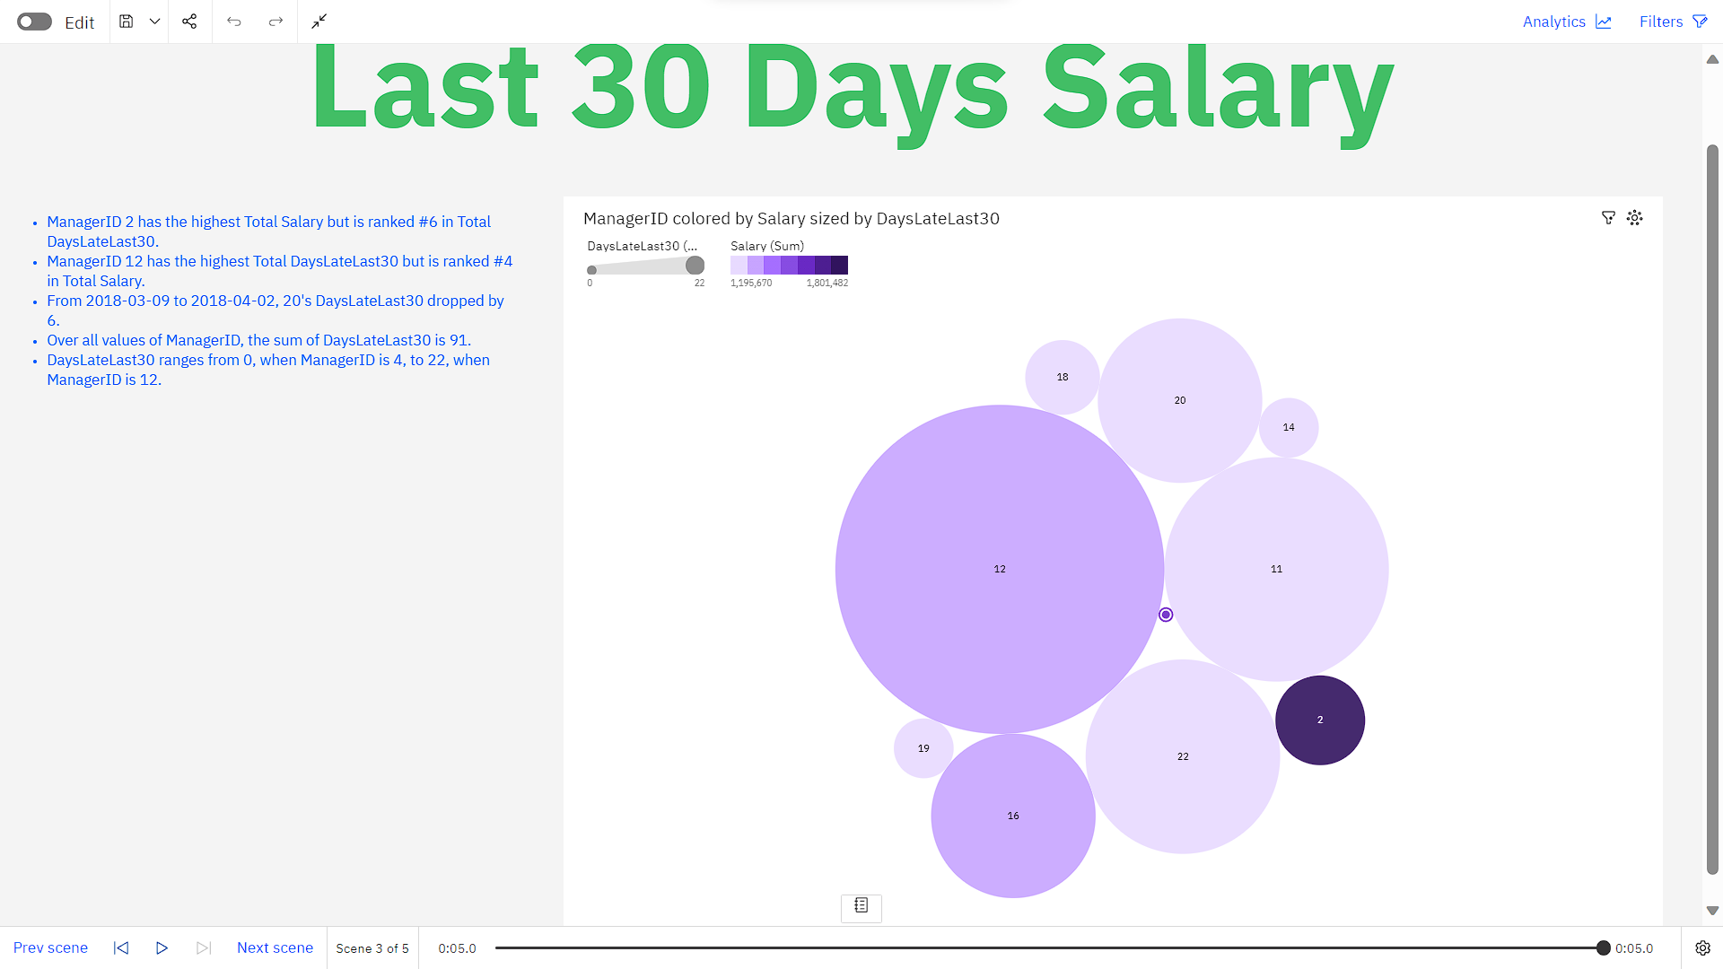

Slide 14
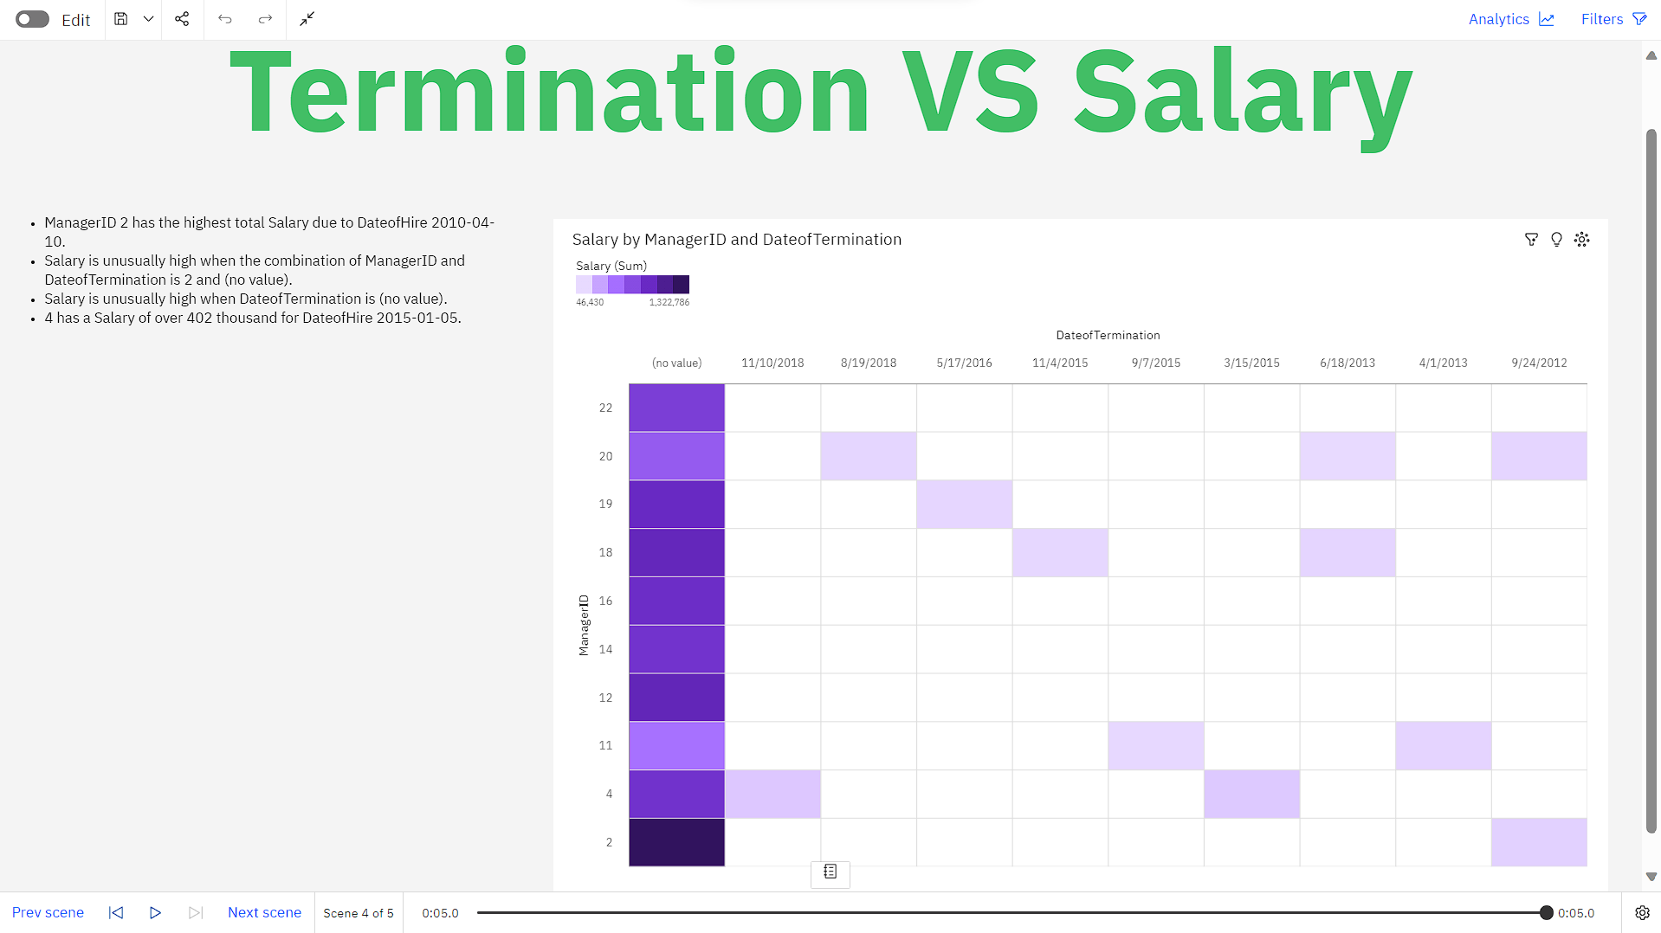

Slide 15
